Slide 1
Data Structures and Algorithms (10)

Slide 2







Queue
“Queue” is the fancy name for waiting in line
Bus Stop

Slide 3

Problem – Queue in Hospital
Patients waiting for help in Emergency Room
Give priority to
  Severely wounded
  Bleading
  …
  the ones with crash !!!

Slide 4

Problem - Queue in Operating System
Processes waiting for services
Give priority to
  I/O bound
  Interrups
  Eg. small jobs(1page print) may be given priority over large jobs (100pages) …

Slide 5
Priority Queue
Priority Queue is a data structure allowing at least the following two operations:
  insert same like enqueue in nonpriority queues
  deleteMin (/deleteMax) is the priority queue equivalent of queue’s dequeu operation (i.e. find and remove the element with minimum (/maximum) priority)
Efficient implementation of priority queue ADTs
Uses and implementation of priority queues

Slide 6
Priority Queues
Queue:
  First in, first out
  First to be removed: First to enter
Priority Queue:
  First in, highest (/lowest) priority element out
  First to be removed: element with highest (/lowest) priority
  Operations: Insert(), Remove-top()

Slide 7
Applications
Process scheduling
  Give CPU resources to most urgent task
Communications
  Send most urgent message first
Event-driven simulation
  Pick next event (by time) to be simulated

Slide 8
Priority Queue implementations
  Number of different priority categories is known
  One queue for each priority
Algorithm
enqueue
  put in to proper queue
dequeue
  get from P1 first
  then get from P2
  then get from P3
  …
  then get from P123
P1
a1 a4
P2
b3 b1 b27 b3 b3
P3
c6 c4 c9
.
.
.
P123
α7 α12 α41

Slide 9
Priority Queue implementations
  Number of different priority categories is unknown
  One queue for each priority
P1
a1 a4
Algorithm
enqueue
  put in to proper queue
dequeue
  get from P1 first
  then get from P2
  then get from P3
  …
  then get from P123
P2
b3 b1 b27 b3 b3
P3
c6 c4 c9
.
.
.
P123
α7 α12 α41

Slide 10
Types of priority queues
Ascending priority queue
  Removal of minimum-priority element
  Remove-top(): Removes element with min priority
Descending priority queue
  Removal of maximum-priority element
  Remove-top(): Removes element with max priority

Slide 11
Generalizing queues and stacks
Priority queues generalize normal queues and stacks
Priority set by time of insertion
Stack: Descending priority queue
Queue (normal): Ascending priority queue

Slide 12
Priority Queue implementation(2)
Sorted linked-list, with head pointer
Insert()
  Search for appropriate place to insert
  O(n)
Remove()
  Remove first in list
  O(1)

Slide 13
Priority Queue implementation(3)
Unsorted linked-list, with head pointer
Insert()
  Insert at the end of linked list
  O(1)
Remove()
  Search for the element (e) with min or max priority
  Remove element (e)
  O(n)

Slide 14
Priority Queue implementation(3)
Heap: Almost-full binary tree with heap property
Almost full:
  Balanced (all leaves at max height h or at h-1)
  All leaves to the left
Heap property: Parent >= children (descending)
  True for all nodes in the tree
  Note this is very different from binary search tree (BST)

Slide 15
Heap Examples
24
16
15
10
3
11
12
4
2
1
Heap or not?
Heap

Slide 16
Heap Examples
24
16
15
10
3
17
12
4
2
1
Heap or not?
Not Heap
(does not maintain heap property)
(17 > 15)

Slide 17
Heap Examples
24
16
15
10
3
11
12
4
2
1
Heap or not?
Not Heap
(balanced, but leaf with priority 1 is not in place)

Slide 18
Representing heap in an array
Representing an almost-complete binary tree
For parent in index i (i >= 0)
  Left child in: i*2 + 1
  Right child in: i*2 + 2
From child to parent:
  Parent of child c in: (c-1)/2

Slide 19
Example
0
24
1
2
16
13
4
5
3
6
14
3
11
12
4
2
1
7
8
9
In the array:
24 16 13 14 3 11 12 4 2 1
Index: 0 1 2 3 4 5 6 7 8 9

Slide 20
Heap property
Heap property: parent priority >= child
  For all nodes
Any sub-tree has the heap property
  Thus, root contains max-priority item
Every path from root to leaf is descending
  This does not mean a sorted array
  In the array:
24 16 13 14 3 11 12 4 2 1

Slide 21
Maintaining heap property (heapness)
Remove-top():
  Get root
  Somehow fix heap to maintain heapness
Insert()
  Put item somewhere in heap
  Somehow fix the heap to maintain heapness

Slide 22
Remove-top(array-heap h)
if h.length = 0 // num of items is 0
return NIL
t ← h[0]
h[0]← h[h.length-1] // last leaf
h.length ← h.length – 1
heapify_down(h, 0) // see next
return t

Slide 23
Heapify_down()
Takes an almost-correct heap, fixes it
Input: root to almost-correct heap, r
Assumes: Left subtree of r is heap
Right subtree of r is heap
but r maybe < left or right roots
Key operation: interchange r with largest child.
Repeat until in right place, or leaf.

Slide 24
Remove-top() example:
0
24
1
2
16
13
4
5
3
6
14
3
11
12
4
2
1
7
8
9
In the array:
24 16 13 14 3 11 12 4 2 1
Index: 0 1 2 3 4 5 6 7 8 9

Slide 25
Remove-top() example:
0
Out: 24
1
1
2
16
13
4
5
3
6
14
3
11
12
4
2
7
8
9
In the array:
1 16 13 14 3 11 12 4 2
Index: 0 1 2 3 4 5 6 7 8 9

Slide 26
Remove-top() example:
0
16
1
2
1
13
4
5
3
6
14
3
11
12
4
2
7
8
9
In the array:
16 1 13 14 3 11 12 4 2
Index: 0 1 2 3 4 5 6 7 8 9

Slide 27
Remove-top() example:
0
16
1
2
14
13
4
5
3
6
1
3
11
12
4
2
7
8
9
In the array:
16 14 13 1 3 11 12 4 2
Index: 0 1 2 3 4 5 6 7 8 9

Slide 28
Remove-top() example:
0
16
1
2
14
13
4
5
3
6
4
3
11
12
1
2
7
8
9
In the array:
16 14 13 4 3 11 12 1 2
Index: 0 1 2 3 4 5 6 7 8 9

Slide 29
Heapify_down(heap-array h, index i)
l ← LEFT(i) // 2*i+1
r ← RIGHT(i) // 2*i+2
if l < h.length // left child exists
if h[l] > h[r]
largest ← l
else largest ← r
if h[largest] > h[i] // child > parent
swap(h[largest],h[i])
Heapify_down(h,largest) // recursive

Slide 30
Remove-top() Complexity
Removal of root – O(1)
Heapify_down() – O(height of tree)
O(log n)
Remove-top() - O(log n)

Slide 31
Insert(heap-array h, item t)
Insertion works in a similar manner
We put the new element at the end of array
Exchange with ancestors to maintain heapness
    If necessary.
    Repeatedly.
  h[h.length] ← t
  h.length ← h.length + 1
  Heapify_up(h, h.length) // see next

Slide 32
Insert() example:
0
In: 15
24
1
2
16
13
4
5
3
6
14
3
11
12
4
2
1
7
8
9
In the array:
24 16 13 14 3 11 12 4 2 1
Index: 0 1 2 3 4 5 6 7 8 9

Slide 33
Insert() example:
0
24
1
2
16
13
4
5
3
6
14
3
11
12
4
2
1
15
7
8
9
10
In the array:
24 16 13 14 3 11 12 4 2 1 15
Index: 0 1 2 3 4 5 6 7 8 9 10

Slide 34
Insert() example:
0
24
1
2
16
13
4
5
3
6
14
15
11
12
4
2
1
3
7
8
9
10
In the array:
24 16 13 14 15 11 12 4 2 1 3
Index: 0 1 2 3 4 5 6 7 8 9 10

Slide 35
Heapify_up(heap-array h, index i)
p ← PARENT(i) // floor( (i-1)/2 )
if p < 0
return // we are done
if h[i] > h[p] // child > parent
swap(h[p],h[i])
Heapify_up(h,p) // recursive

Slide 36
Insert() Complexity
Insertion at end – O(1)
Heapify_up() – O(height of tree)
O(log n)
Insert() - O(log n)

Slide 37
Priority queue as heap as binary tree in array
Complexity is O(log n)
  Both insert() and remove-top()
Must pre-allocate memory for all items
Can be used as efficient sorting algorithm
Heapsort()

Slide 38
Heapsort(array a)
h ← new array of size a.length
for i←1 to a.length
insert(h, a[i]) // heap insert
i ← 1
while not empty(h)
a[i] ← remove-top(h) // heap op.
i ← i+1
Complexity: O(n log n)

Slide 39
Building a heap
Use MaxHeapify to convert an array A into a max-heap.
How?
Call MaxHeapify on each element in a bottom-up manner.
BuildMaxHeap(A)
1. heap-size[A] ← length[A]
2. for i ← ⎣length[A]/2⎦ downto 1
3. do MaxHeapify(A, i)

Slide 40
BuildMaxHeap – Example
Input Array:
24
21
23
22
36
29
30
34
28
27
Initial Heap:
(not max-heap)
24
21
23
22
36
29
30
34
28
27

Slide 41
Data Structure Binary Heap
Array viewed as a nearly complete binary tree.
  Physically – linear array.
  Logically – binary tree, filled on all levels (except lowest.)
Map from array elements to tree nodes and vice versa
  Root – A[1]
  Left[i] – A[2i]
  Right[i] – A[2i+1]
  Parent[i] – A[⎣i/2⎦]
length[A] – number of elements in array A.
heap-size[A] – number of elements in heap stored in A.
  heap-size[A] ≤ length[A]

Slide 42
Heap Property (Max and Min)
Max-Heap
  For every node excluding the root,
  value is at most that of its parent: A[parent[i]] ≥ A[i]
Largest element is stored at the root.
In any subtree, no values are larger than the value stored at subtree root.
Min-Heap
  For every node excluding the root,
  value is at least that of its parent: A[parent[i]] ≤ A[i]
Smallest element is stored at the root.
In any subtree, no values are smaller than the value stored at subtree root

Slide 43
Heaps – Example
26
24
20
18
17
19
13
12
14
11
Max-heap as an
array.
1 2 3 4 5 6 7 8 9 10
Max-heap as a binary
tree.
26
24
20
18
17
19
13
12
14
11
Last row filled from left to right.

Slide 44
Height
Height of a node in a tree: the number of edges on the longest simple downward path from the node to a leaf.
Height of a tree: the height of the root.
Height of a heap: ⎣lg n ⎦
  Basic operations on a heap run in O(lg n) time

Slide 45
Heaps in Sorting
Use max-heaps for sorting.
The array representation of max-heap is not sorted.
Steps in sorting
  Convert the given array of size n to a max-heap (BuildMaxHeap)
  Swap the first and last elements of the array.
    Now, the largest element is in the last position – where it belongs.
    That leaves n – 1 elements to be placed in their appropriate locations.
    However, the array of first n – 1 elements is no longer a max-heap.
    Float the element at the root down one of its subtrees so that the array remains a max-heap (MaxHeapify)
    Repeat step 2 until the array is sorted.

Slide 46
Heap Characteristics
Height = ⎣lg n⎦
No. of leaves = ⎡n/2⎤
No. of nodes of
height h ≤ ⎡n/2^{h+1}⎤

Slide 47

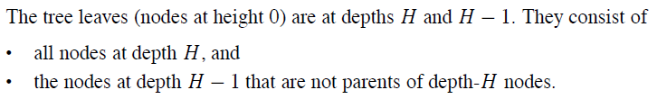

Prove that there are at most nodes of height h in an n element heap.

Slide 48





Slide 49





Slide 50
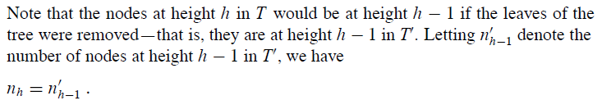


Slide 51
Maintaining the heap property
Suppose two subtrees are max-heaps,
but the root violates the max-heap
property.
Fix the offending node by exchanging the value at the node with the larger of the values at its children.
  May lead to the subtree at the child not being a heap.
Recursively fix the children until all of them satisfy the max-heap property.

Slide 52
MaxHeapify – Example
MaxHeapify(A, 2)
26
24
24
14
20
14
18
17
19
18
14
14
24
13
12
14
14
18
11

Slide 53
Procedure MaxHeapify
MaxHeapify(A, i)
1. l ← left(i)
2. r ← right(i)
3. if l ≤ heap-size[A] and A[l] > A[i]
4. then largest ← l
5. else largest ← i
6. if r ≤ heap-size[A] and A[r] > A[largest]
7. then largest ← r
8. if largest≠ i
9. then exchange A[i] ↔ A[largest]
10. MaxHeapify(A, largest)
Assumption:
Left(i) and Right(i) are max-heaps.

Slide 54
Running Time for MaxHeapify
MaxHeapify(A, i)
1. l ← left(i)
2. r ← right(i)
3. if l ≤ heap-size[A] and A[l] > A[i]
4. then largest ← l
5. else largest ← i
6. if r ≤ heap-size[A] and A[r] > A[largest]
7. then largest ← r
8. if largest≠ i
9. then exchange A[i] ↔ A[largest]
10. MaxHeapify(A, largest)
Time to fix node i and its children = Θ(1)
PLUS
Time to fix the subtree rooted at one of i’s children = T(size of subree at largest)

Slide 55
Building a heap
Use MaxHeapify to convert an array A into a max-heap.
How?
Call MaxHeapify on each element in a bottom-up manner.
BuildMaxHeap(A)
1. heap-size[A] ← length[A]
2. for i ← ⎣length[A]/2⎦ downto 1
3. do MaxHeapify(A, i)

Slide 56
BuildMaxHeap – Example
Input Array:
24
21
23
22
36
29
30
34
28
27
Initial Heap:
(not max-heap)
24
21
23
22
36
29
30
34
28
27

Slide 57
BuildMaxHeap – Example
MaxHeapify(⎣10/2⎦ = 5)
MaxHeapify(4)
24
36
MaxHeapify(3)
24
MaxHeapify(2)
21
30
34
24
21
23
36
23
MaxHeapify(1)
36
36
27
21
29
36
21
30
28
23
34
22
24
22
34
22
28
24
27
21

Slide 58
Correctness of BuildMaxHeap
Loop Invariant: At the start of each iteration of the for loop, each node i+1, i+2, …, n is the root of a max-heap.
Initialization:
  Before first iteration i = ⎣n/2⎦
  Nodes ⎣n/2⎦+1, ⎣n/2⎦+2, …, n are leaves and hence roots of max-heaps.
Maintenance:
  By LI, subtrees at children of node i are max heaps.
  Hence, MaxHeapify(i) renders node i a max heap root (while preserving the max heap root property of higher-numbered nodes).
  Decrementing i reestablishes the loop invariant for the next iteration.

Slide 59
Running Time of BuildMaxHeap
Loose upper bound:
  Cost of a MaxHeapify call × No. of calls to MaxHeapify
  O(lg n) × O(n) = O(nlg n)
Tighter bound:
  Cost of a call to MaxHeapify at a node depends on the height, h, of the node – O(h).
  Height of most nodes smaller than n.
  Height of nodes h ranges from 0 to ⎣lg n⎦.
  No. of nodes of height h is ⎡n/2^{h+1}⎤

Slide 60
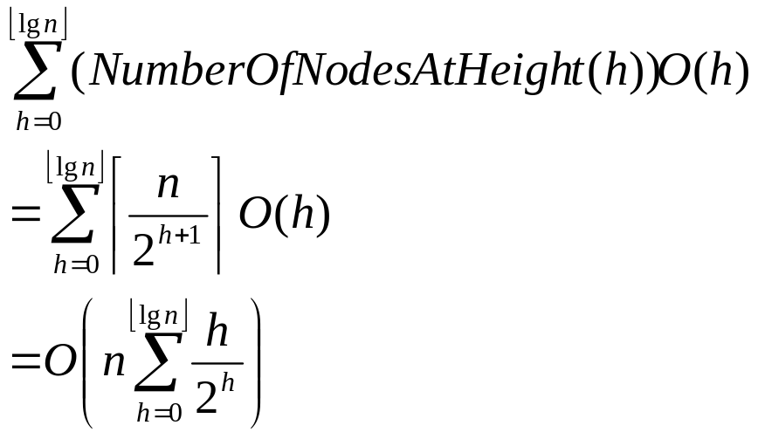
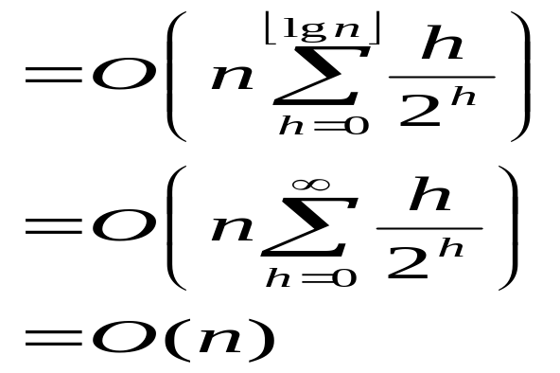
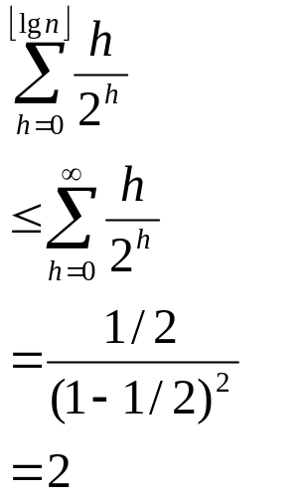
Running Time of BuildMaxHeap
T(BuildMaxHeap) =
Can build a heap from an unordered array in linear time
Tighter Bound for T(BuildMaxHeap)

Slide 61
Thank You!!

